Slide 1
THE EVOLVING/ STRATEGIC ROLE OF HUMAN RESOURCE MANAGEMENT

Slide 2
Strategic Human Resource Management
Involves development of consistent, aligned collection of practices, programs, & policies to facilitate achievement of strategic objectives
Requires abandoning mindset & practices of “personnel management” & focusing on strategic issues rather than operational issues
Integration of all HR programs within larger framework, facilitating mission & objectives
Writing down strategy facilitates involvement & buy-in of senior executives & other employees

Slide 3
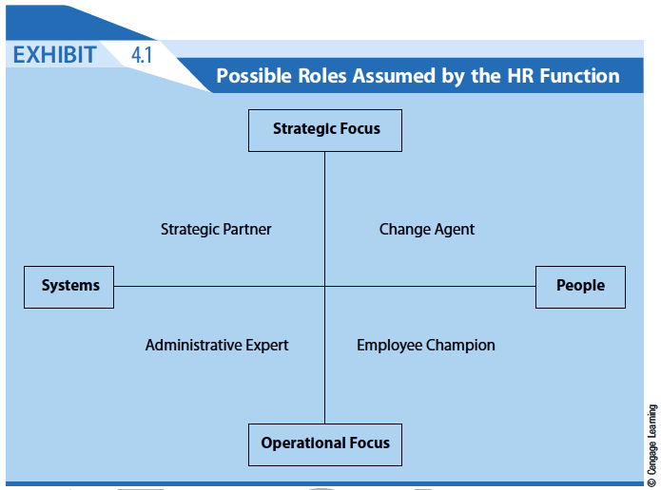

Slide 4
HR Roles in Knowledge-Based Economy
Human capital steward
Creates an environment & culture in which employees voluntarily contribute skills, ideas, & energy
Human capital is not “owned” by organization
Knowledge facilitator
Procures necessary employee knowledge & skill sets that allow information to be acquired, developed, & disseminated
Provides a competitive advantage
Must be part of strategically designed employee development plan

Slide 5
HR Roles in Knowledge-Based Economy
Relationship builder
Develops structure, work practices, & culture that allow individuals to work together
Develops networks that focus on strategic objectives
Rapid deployment specialist
Creates fluid & adaptable structure & systems
Global, knowledge-based economy mandates flexibility & culture that embraces change

Slide 6
SHRM Critical Competencies
HR’s success as true strategic business partner dependent on five specific competencies:
Strategic contribution - development of strategy
Business knowledge - understanding nuts & bolts of organization
Personal credibility - measurable value demonstrated in programs & policies
HR delivery - serving internal customers through effective & efficient programs
HR technology - using technology to improve organization’s management of people

Slide 7
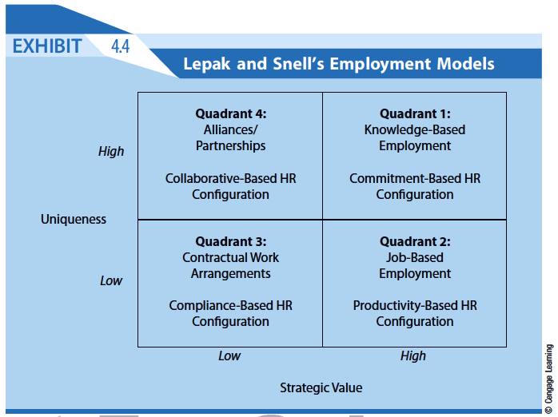

Slide 8
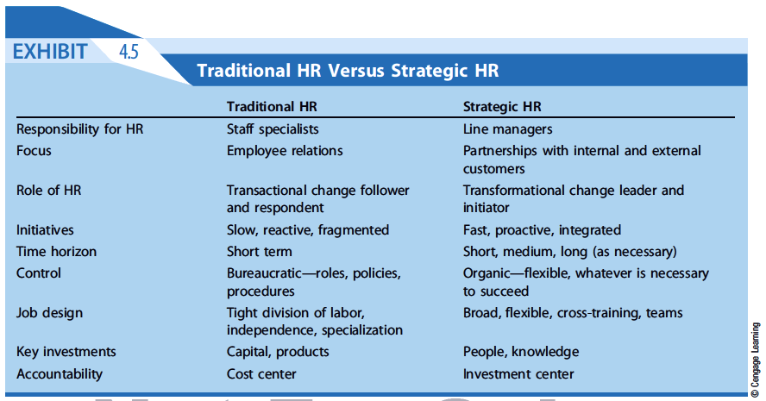

Slide 9
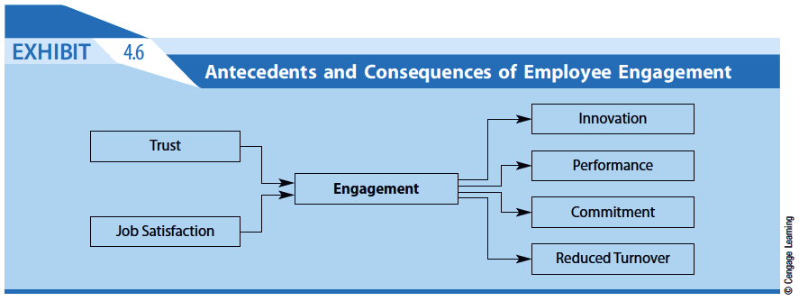

Slide 10
Barriers to Strategic HR
Strategic contribution
Business knowledge
Personal credibility
HR delivery
HR technology

Slide 11
